Slide 1
Language in 10 minutes:
French
Français

Slide 2
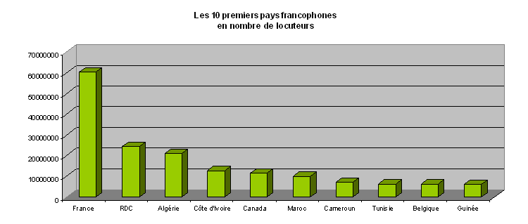
Where is French spoken?
10 countries with the most French speakers
70
60
50
40
30
20
10
0
millions
Côte
d’Ivoire
France Congo Algeria Canada Morocco Cameroon Tunisia Belgium Guinea
9th most spoken language; spoken on all 5 continents
  More French speakers in Africa than Europe
Official language in 29 countries
Official language of: United Nations, European Union, African Union, Organization of American States, European Parliament, Canadian Parliament (Hansard), NATO, …
Parallel corpora!
http://www.francophonie.org/English.html

Slide 3
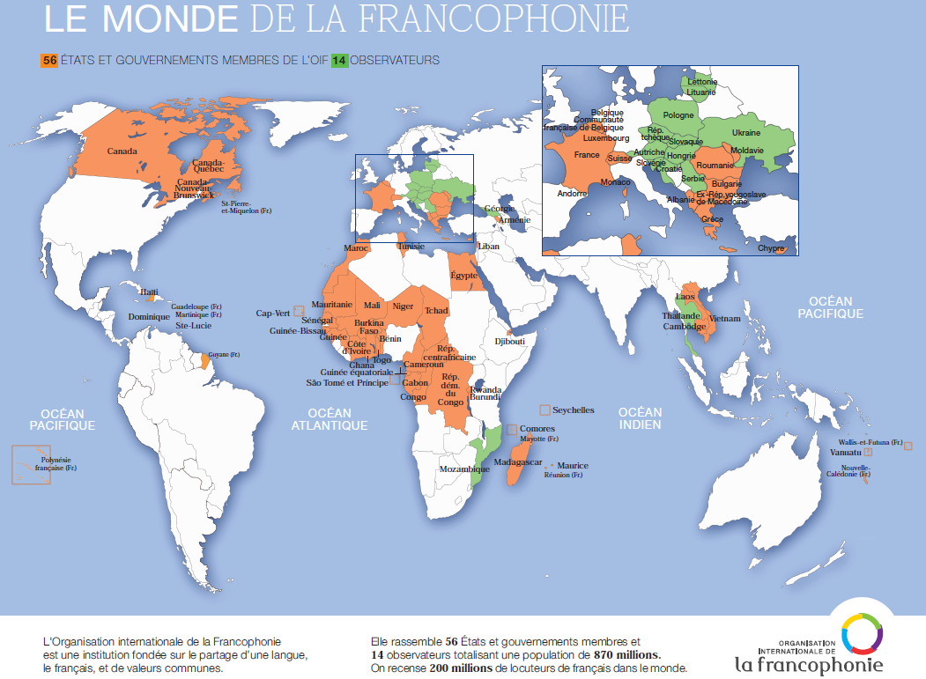

Slide 4
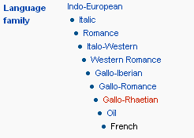
French Facts
Romance language
  Descendant of Latin
“Lingua franca” of Europe
from 17th to mid-20th century
  Influence on other languages
Large colonial power
  Also influenced by other languages: ~12% of French words are foreign origin (English, Italian, German, Arabic, …)
Académie française “official authority on the French language” since 1635
  Spelling reforms (e.g., [un]successful 1990 reforms)
  Tries to avoid Anglicization (courriel vs email); only partly successful
  Gender/occupation controversies (la/le ministre)
http://en.wikipedia.org/wiki/French_language

Slide 5
French Language
Latin alphabet, plus accents and cedilla
  é, à, è, ù, â, ê, î, ô, û, ë, ï, ü, ÿ, ä, ö, ü, ç
Capitalization rules quite different than English
  Affects named entity tagging, MT
  Uncapitalized: days of week, months, geographical words, language names, nationalities, religions, long organization names, titles, …
Gustave FLAUBERT
Le bon Usage
Le Progrès de la Civilisation au XXe siècle
Un Coeur simple
le Fonds monétaire international
le ministère de l'Industrie et du Commerce
Organisation de coopération et de développement économiques
Docteur Martin, comment allez-vous ?
Le docteur Martin habite à côté
l’océan Pacifique
http://french.about.com/library/writing/bl-capitalization.htm

Slide 6
Morphology
Two Grammatical genders
  Il est un grand acteur : He is a great actor
Elle est une grande actrice : She is a great actress
  Nouns, most pronouns inflected for number and gender
  Nouns have gender, either masculine or feminine (even if the noun is inanimate) e.g. crayon(m) -- pencil, stylo (f) -- pen
  Regular nouns have masculine noun ending : -ag, -ier etc and feminine noun ending : -ade, -aison etc
  Plural formed by suffix -s --there are irregular plural forms
  Adjectives inflect for the number and gender of their nouns. e.g. (the big building – le grand bâtiment) against (the big house – la grande maison)
  Determiners have gender too!

Slide 7
Morphology
Verbs: four moods – indicative, imperative, subjunctive, and conditional
About 20 tenses total (simple + compound)
Indicative mood has five "simple" (synthetic) tenses
Key issue: Increase in data sparsity and ambiguity
Adverbs do not display any inflection
    In most cases, formed by adding the suffix -ment ("-ly") to the adjective's feminine singular form e.g. lent ("slow") to lentement ("slowly")
    exceptions: adjective ends in an i use masculine adj stem e.g. vrai -- vraiment ("real" – "really"), irregular derivation, adverbs not derived from adjectives
http://www.lerc.educ.ubc.ca/LERC/courses/489/worldlang/french/frenchlanguagedescription.html
http://en.wikipedia.org/wiki/French_verbs
présent
je chante
I sing, I'm singing
imparfait
je chantais
I was singing
passé simple
je chantai
I sang, I've sung
futur
je chanterai
I will sing
conditionnel
je chanterais
I would sing

Slide 8
Spoken vs. Written French
5 verb tenses are commonly used in written French, but never in spoken French
  MT system should be trained on appropriate data
Literary | Spoken
Il choisit. - He chose. | Il a choisi. - He has chosen.
Quand il eut choisi, nous rîmes. - When he had chosen, we laughed. | Quand il avait choisi, nous avons ri. - When he had chosen, we laughed.
J'ai voulu qu'il choisît. - I wanted him to choose. (I wanted that he chose) | J'ai voulu qu'il choisisse. - I wanted him to choose. (I wanted that he choose)
J'aurais voulu qu'il eût choisi. - I would have wanted him to choose. (I would have wanted that he had chosen) | J'aurais voulu qu'il ait choisi. - I would have wanted him to choose. (I would have wanted that he has chosen)
Si je l'eus vu, je l'eusse acheté. - If I had seen it, I would have bought it. | Si je l'avais vu, je l'aurais acheté. - If I had seen it, I would have bought it.
http://french.about.com/od/grammar/a/literarytenses_2.htm

Slide 9
Syntax "What is not clear is not French"- De Rivarol
Declarative word order – subject verb object
Je lisais un livre: I was reading a book
Exceptions
* If object is a pronoun, it precedes the verb
Je le lisais : I was reading it
* Inversion of subject and verb
Mangeons-nous de la salade ? : Are we eating salad?
Position of Adjectives
* Usually, Adj placed after noun
une table ronde - round table
* 'BAGS' placed before noun
une jolie fille - pretty girl
  http://french.about.com/
  http://en.wikipedia.org/wiki/French_grammar

Slide 10
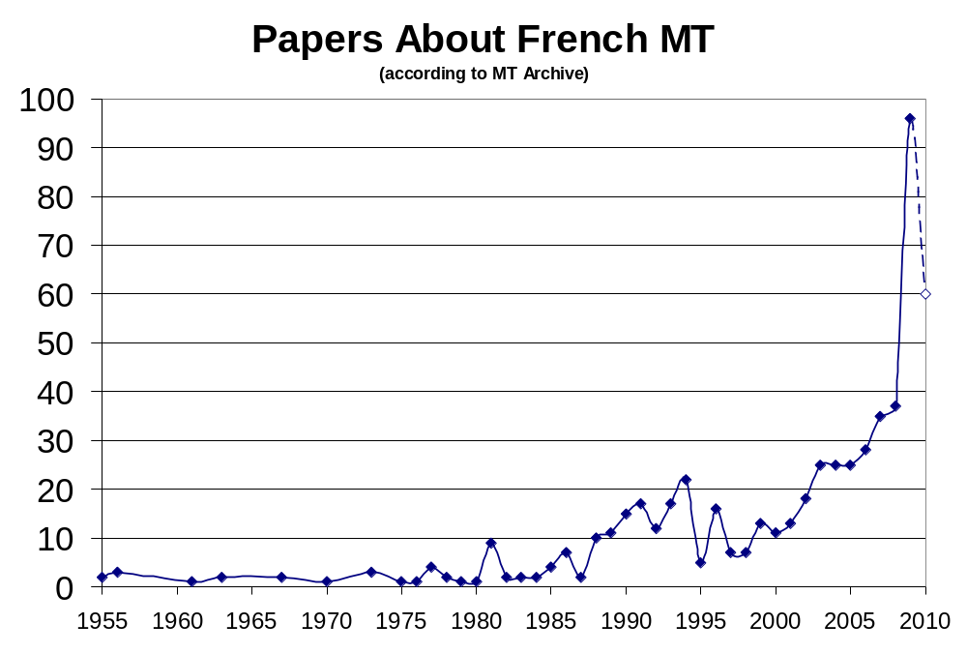
History of French MT
First WMT
06
“We are of the opinion that most of the problems which attend the translation of French into English by machine have now been solved.”
Andrew Booth, 1956, Present Objectives of MT Research in the United Kingdom.
Giza
Och & Ney 03
Europarl
Koehn 95
IBM Candide,
DellaPietra & DellaPietra 94
IBM models 1-5,
Brown et al. 93
Sentence alignment,
Hansards corpus
Gale & Church 91
Systran Fr-En
Gouin 70
METEO
Chandioux 76

Slide 11
French MT Research: Survey of some recent papers
* METEOR-NEXT and the METEOR Paraphrase Tables metric for five languages (Michael Denkowski and Alon Lavie 2010)
* Machine aided human translation system for French to English translation (Hani Safadi et al 2009)
* The AFP corpus: NE corpus of 30,000 news wires (Djamel Mostefa et al. 2010)
* MultiUN ver 1 multilingual parallel corpus extracted from official documents of the UN (Andreas Eisele & Yu Chen 2010)
* Research on French to/from:
Arabic, Chinese, Dutch, English, German, Italian, Japanese, Polish, Russian, Spanish, Vietnamese

Slide 12
French-English MT Resources
There are lots of resources but one has to be careful in distinguishing between corpus based on Spoken French vs. Written French
Parallel corpora mainly used:
  Canadian Hansard French-English parallel texts
  Data from UN
  Europarl-v4 corpus (Koehn, 2005)
  Gigaword corpus provided by LDC
  American and French Research on the Treasury of the French Language(ARTFL)
MT archive, ACL anthology - huge collection of papers!
  Also research in French, e.g. ATALA (Association pour le Traitement Automatique des Langues)
MT systems
SYSTRAN, GOOGLE translate etc

Slide 13
Merci!

